Slide 1
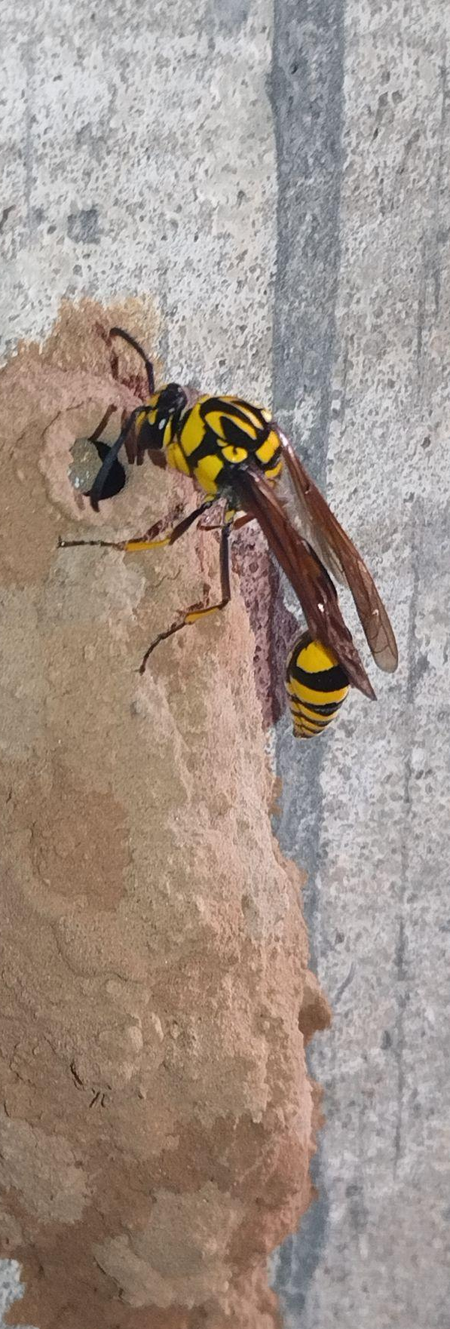
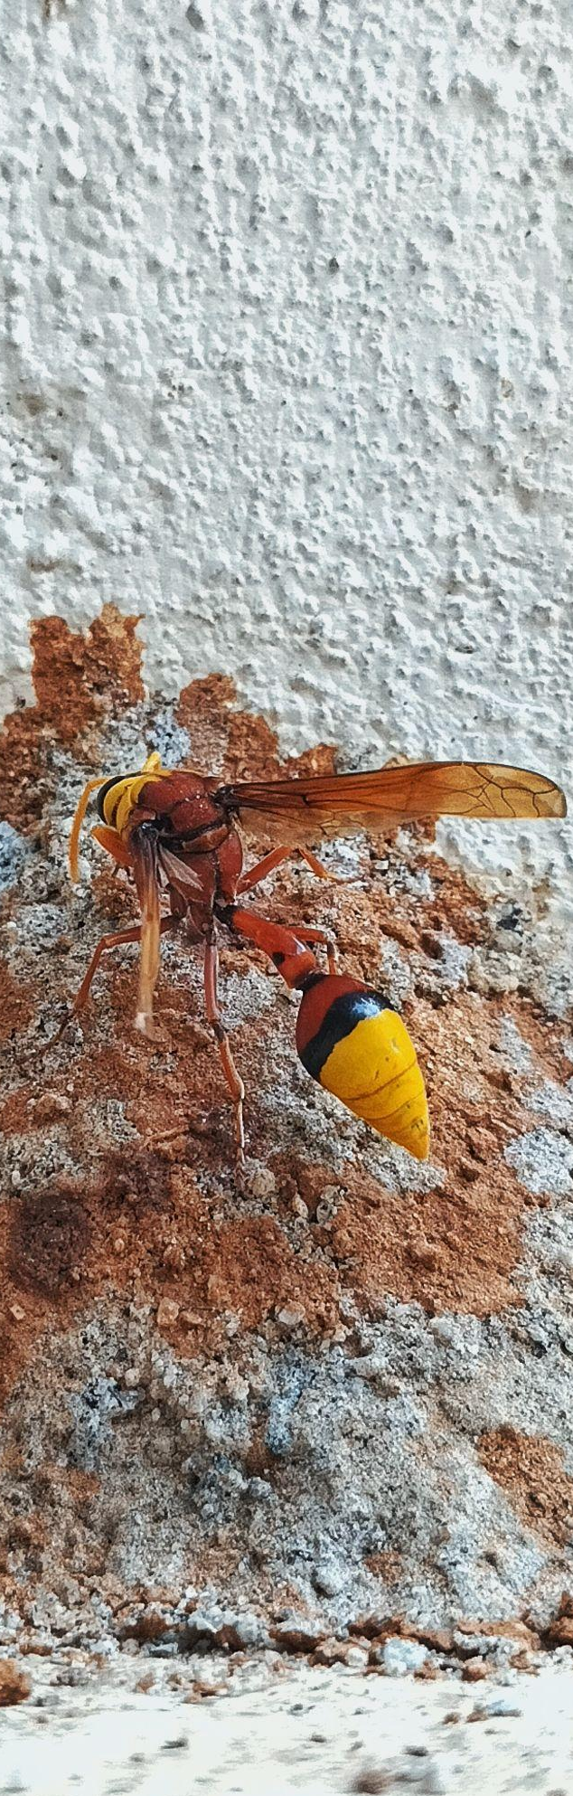
Phylogenetic Tree
MS21078 - Potter Wasp
Overview of Potter Wasps
Potter wasps are a group of Solitary wasps
Belongs to the subfamily Eumeninae within the family Vespidae
known for their unique and artistic pot-shaped mud nests
Taxa Included for Phylogenetic Tree Construction
Outgroups: Apis (Apis dorsata), Crabro (Crabro latipes) : 2 species
Ingroups (Genus names): Eumenes, Phimenes, Delta, Zeta, Katamenes, Euodynerus, Ancistrocerus, Parancistrocerus : Total 48 species
All Ingroups species are from Sub family Eumeninae
Phimenes sp.
Photographs by the author, Personal collection, Year: 2023, Location: IISc Bangalore
You can access all the data, files, materials, Tree images and results in the following GitHub repository: GitHub Link
Delta sp.

Slide 2
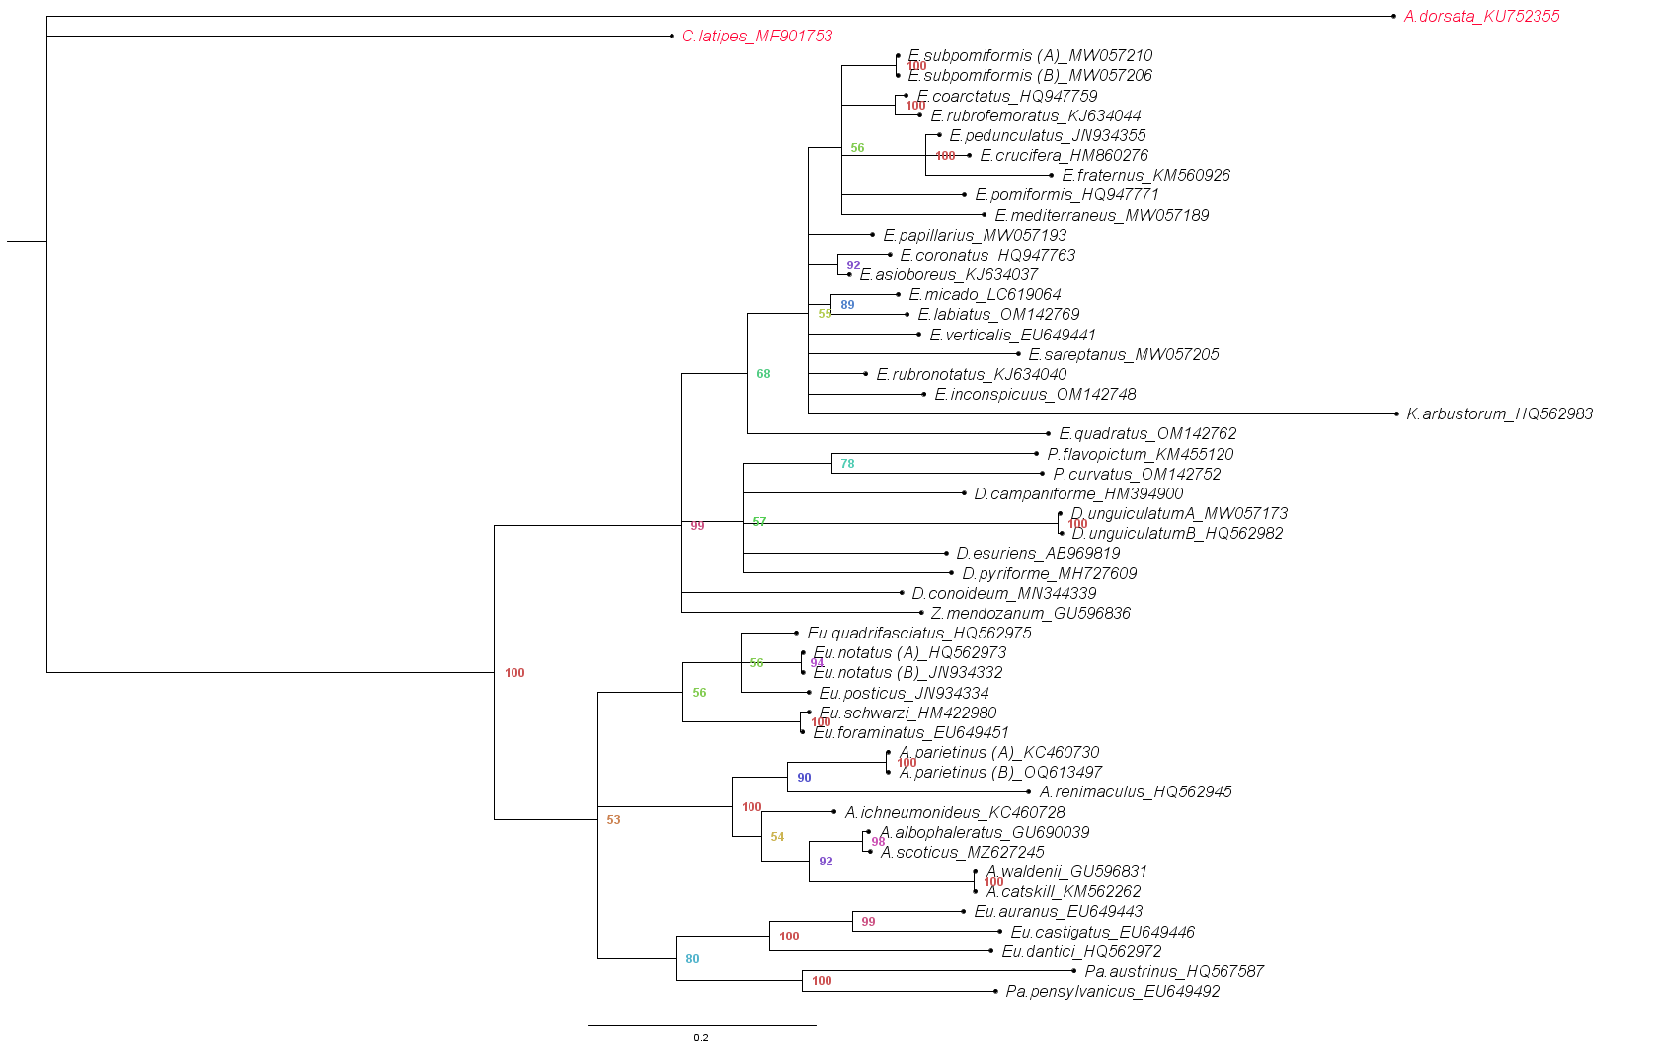
Phylogenetic Tree
Outgroups Genus Labels;
A: Apis
C: Crabro
Ingroups Genus Labels;
E: Eumenes
P: Phimenes
D: Delta
Z: Zeta
Eu: Euodynerus
A: Ancistrocerus
Pa: Parancistrocerus
K: Katamenes
Red coloured taxa: Outgroup
Coloured Number: Posterior Probability
(with red indicating higher probabilities and green indicating lower probabilities)
Species names and their associated accession numbers are used to label the taxa

